Slide 1

Natural Language Processing
Rohit Kate
Language Models – Part 2

Slide 2
Reading
Section 5.5 and 5.6, Textbook 1 (skip the code)

Slide 3
Training and Testing a Language Model
A language model must be trained on a large corpus of text to get good estimates of the probabilities
Model can be evaluated based on its ability to predict a high probability for a test corpus (not overlapping with training corpus)
Ideally, the training (and test) corpus should be representative of the actual application data

Slide 4
Unknown Words
How to handle words in the test corpus that did not occur in the training data, i.e. out of vocabulary (OOV) words?
Train a model that includes an explicit symbol for an unknown word (<UNK>).
Choose a vocabulary in advance and replace other words in the training corpus with <UNK>
Estimate the probabilities associated with <UNK> like any other word
Alternatively, replace the first occurrence of each word in the training data with <UNK>
No need to choose a vocabulary

Slide 5
Generative Model of a Language
An N-gram model can be seen as a probabilistic automata for generating sentences.
Append a unique start (<start>) and end (<end>) symbol to every sentence and treat these as additional words
Start with an <start> symbol
Until <end> is generated do:
Stochastically pick the next word based on the conditional
probability of each word given the previous N −1 words.

Slide 6
Evaluation of an LM
Ideally, evaluate use of model in end application (e.g. speech recognition, machine translation etc.) (called extrinsic evaluation)
Realistic
Expensive
Evaluate on ability to model test corpus (called intrinsic evaluation)
Less realistic
Cheaper
Does not guarantee improvement on end applications but often correlates

Slide 7
Perplexity
Perplexity (PP) is a measure of how well a probability model predicts a sample data
Measure of how well a model “fits” the test data
Low perplexity indicates a better fit
Model is less “perplexed” by the test data which it never saw before
Uses the probability that the model assigns to the test corpus
The better model will assign a higher probability to the test data
It is an intrinsic evaluation measure

Slide 8

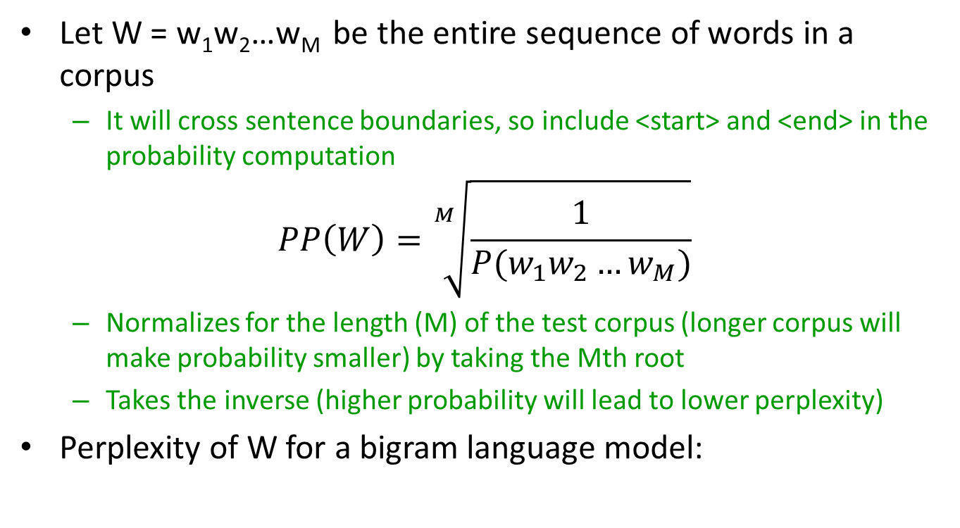
Perplexity
Let W = w₁w₂…w_{M} be the entire sequence of words in a corpus
It will cross sentence boundaries, so include <start> and <end> in the probability computation
$$PP\left(W\right)=\sqrt[M]{\frac{1}{P(w_{1}w_{2}…w_{M})}}$$
Normalizes for the length (M) of the test corpus (longer corpus will make probability smaller) by taking the Mth root
Takes the inverse (higher probability will lead to lower perplexity)
Perplexity of W for a bigram language model:
$$PP\left(W\right)=\sqrt[M]{\prod_{i=1}^{M}{\frac{1}{P(w_{i}|w_{i−1})}}}$$

Slide 9
Model Combination
As N increases, the power (expressiveness) of an N-gram model increases, but the ability to estimate accurate probabilities from data decreases
A general approach is to combine the results of multiple N-gram models of increasing complexity

Slide 10
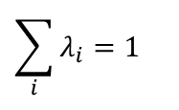
Interpolation
Linearly combine estimates of N-gram models of increasing order
Interpolated Trigram Model:
Trigram
Bigram
Unigram
$$\hat{P}(w_{n}|w_{n−2,}w_{n−1})=λ_{1}P(w_{n}|w_{n−2,}w_{n−1})+λ_{2}P(w_{n}|w_{n−1})+λ_{3}P(w_{n})$$
Where:
$$\sum_{i}{λ_{i}}=1$$
Learn proper values for λ_{i} by training to (approximately) maximize the likelihood of an independent validation (also known as holdout) corpus

Slide 11
Domain-specific LMs
Using a domain-specific corpus one can build a domain-specific language model
For example, train a language model for each difficulty level (grades 1 to 12)
Then automatically predict difficulty level of a new document and recommend for the grade level (model for whichever difficulty level gives the highest probability for the document)

Slide 12
Large N-gram Language Models
Google had released a 5-gram LM trained on one trillion words
https://ai.googleblog.com/2006/08/all-our-n-gram-are-belong-to-you.html
N-grams Data
https://www.ngrams.info/
Based on the one billion word Corpus of Contemporary American English (COCA; publicly-available, genre-balanced)
https://www.ngrams.info/iweb.asp
Based on 14 billion word iweb corpus (from 22 million web pages)
Not free

Slide 13
Advantages of N-Gram Based Language Models
Easy and fast to train
Scale to large corpora
Work well in practice

Slide 14
Limitations of N-Grams LMs: Long Distance Dependencies
Many times local context does not provide the most useful predictive clues, which instead are provided by long-distance dependencies
Syntactic dependencies
“The man next to the large oak tree near the grocery store on the corner is tall.”
“The men next to the large oak tree near the grocery store on the corner are tall.”
Semantic dependencies
“The bird next to the large oak tree near the grocery store on the corner flies rapidly.”
“The dog next to the large oak tree near the grocery store on the corner barks rapidly.”
More complex models of language that use syntax and semantics are needed to handle such dependencies

Slide 15
Limitations of N-Grams LMs:
Do not scale well with larger ngrams (e.g. 11-gram)
Statistics become sparse
Large space complexity (memory requirement)
Lack of generalization across contexts
Estimates of “black horse” and “white horse” do not influence estimates of “brown horse”
Some of these limitations are overcome by neural language models

Slide 16
RNN-Based Language Model
RNN can be used as a language model
Instead of predicting the label for each word, train it to predict the next word!
Have <start> as the designated start symbol for a sentence and <end> as the end symbol
All words will be input in the form of their embeddings

Slide 17
RNN: Illustration
Please
Output Layer
LSTM
<start>

Slide 18
RNN: Illustration
turn
Output Layer
LSTM
Please

Slide 19
RNN: Illustration
off
Output Layer
LSTM
turn
Note: The prediction is not just based on the current word,
the hidden state is storing a representation of what has been generated so far.

Slide 20
RNN: Illustration
your
Output Layer
LSTM
off

Slide 21
RNN: Illustration
cell
Output Layer
LSTM
your

Slide 22
RNN: Illustration
phone
Output Layer
LSTM
cell

Slide 23
RNN: Illustration
<end>
Output Layer
LSTM
phone

Slide 24
RNN-Based Language Model
Predicting a word is a classification task where each word is a class
Analogous to skip-gram model
Use softmax activation for predictions
Probability for each word
Use cross-entropy loss

Slide 25
RNN: Illustration
Probabilities
… phone dog jumped …
Softmax
LSTM
cell

Slide 26
RNN-Based Language Model
To generate a sentence, the next word will be sampled from the softmax probability distribution
If phone has 0.6 probability then it will be sampled (generated) with 0.6 probability
This way same sentence will not be generated every time
A sentence with higher probability will be more likely generated

Slide 27
RNN-Based Language Model
To train, we need sentences in which the input and output (target) are shifted by one word
It is very easy to create such training data
Target: Please turn off your cell phone <end>
Input: <start> Please turn off your cell phone

Slide 28
Character RNN-Based Language Model
Instead of working with words, RNNs can also be trained to work with characters
Advantages:
It will pick up word morphology (how words are formed) and handle new words more easily, e.g. “doggy”
No problem in handling unknown words (OOV – out of vocabulary)
Disadvantages:
Cannot directly learn about words
Needs to learn how sequence of some characters means something special “d-o-g => dog”

